Slide 1
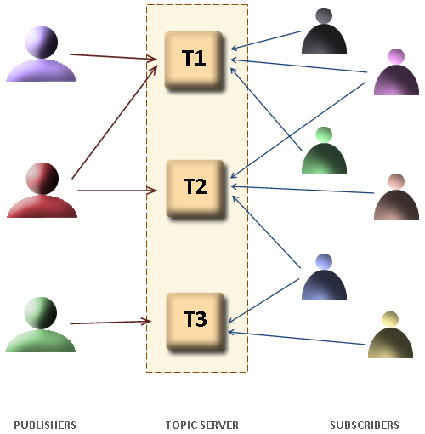


Delegates and Events
Svetlin Nakov
Telerik Corporation
www.telerik.com

Slide 2

Table of Contents
What are Delegates?
Singlecast and Multicast Delegates
Generic Delegates and Anonymous Methods
Predicates
Events
Events vs. Delegates
When to Use Interfaces, Events and Delegates

Slide 3
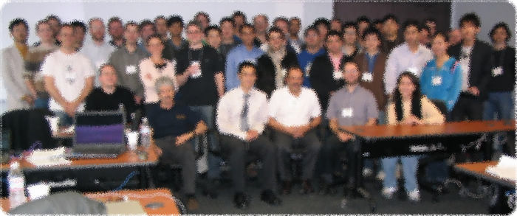

Delegates in .NET Framework

Slide 4
What are Delegates?
Delegates are types that hold a method reference
Describe the signature of given method
Number and types of the parameters
The return type
Their "values" are methods
These methods match their signature (parameters and return types)
Delegates are reference types

Slide 5
What are Delegates? (2)
Delegates are roughly similar to function pointers in C and C++
Contain a strongly-typed pointer (reference) to a method
They can point to both static and instance methods
Used to perform callbacks invocations
Used to implement the "publish-subscribe" model

Slide 6
Delegates – Example
// Declaration of a delegate
public delegate void SimpleDelegate(string param);
public class DelegatesExample
{
public static void TestMethod(string param)
{
Console.WriteLine("I was called by a delegate.");
Console.WriteLine("I got parameter {0}.", param);
}
public static void Main()
{
// Instantiate the delegate
SimpleDelegate d = new SimpleDelegate(TestMethod);
// Invocation of the method, pointed by delegate
d("test");
}
}

Slide 7

Simple Delegate
Live Demo

Slide 8

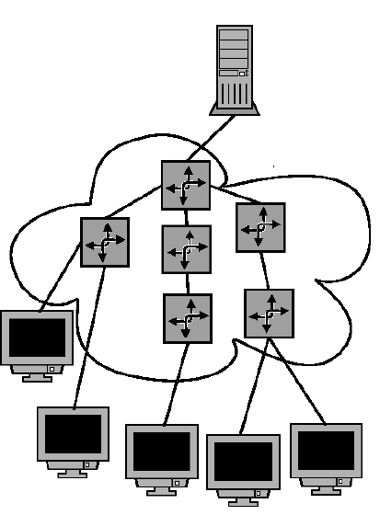
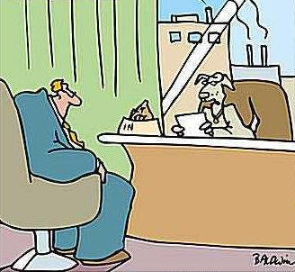
Singlecast and Multicast Delegates

Slide 9
Types of Delegates
Singlecast delegates
Reference to one method only
Multicast delegates
Linked list of references to methods
In C# only multicast delegates are used
Declared using the delegate keyword

Slide 10
Multicast Delegates
When calling a multicast delegate, all the methods of its list are invoked
Delegate may return a value
The result of the execution is the result of the last method invoked
Delegates may contain ref or out parameter
An exception can be thrown by any of the methods of a multicast delegate
The methods after this one are not invoked

Slide 11


Multicast Delegates (2)
When talking about a delegate usually we mean multicast delegate
They inherit System.MulticastDelegate ...
... which inherits a System.Delegate

Slide 12
Properties and Methods
Combine() / += – concatenates the invocation lists of an array of delegates with equal signatures
Remove() / -= – removes a method from the invocation list
GetInvocationList() – returns an array of delegates – one for each of the methods in the invocation list
Method – returns the methods' descriptions in the delegate

Slide 13
Multicast Delegates – Example
public delegate void StringDelegate(string value);
public class TestDelegateClass
{
void PrintString(string value)
{
Console.WriteLine(value);
}
void PrintStringLength(string value)
{
Console.WriteLine("Length = {0}", value.Length);
}
static void PrintInvocationList(Delegate someDelegate)
{
Delegate[] list = someDelegate.GetInvocationList();
foreach (Delegate d in list)
Console.Write(" {0}", d.Method.Name);
}

Slide 14
Multicast Delegates – Example (2)
public static void Main()
{
TestDelegateClass tdc = new TestDelegateClass();
StringDelegate printDelegate =
new StringDelegate(tdc.PrintString);
PrintInvocationList(printDelegate);
// Prints: ( PrintString )
// Invoke the delegate
combinedDelegate("test");
}
}

Slide 15


Multicast Delegates
Live Demo

Slide 16


Generic Delegates

Slide 17
Generic Delegates
A delegate can be generic:
We have a new feature called implicit method group conversion
Applies to all delegate types
Enables you to write the previous line with this simplified syntax:
public delegate void SomeDelegate<T>(T item);
public static void Notify(int i) { }
SomeDelegate<int> d = new SomeDelegate<int>(Notify);
SomeDelegate<int> d = Notify;

Slide 18

Anonymous Methods
Definition and Parameters

Slide 19
Anonymous Methods
We are sometimes forced to create a class or a method just for the sake of using a delegate
The code involved is often relatively short and simple
Anonymous methods lets you define an nameless method called by a delegate
Lambda functions are variant of anonymous methods with shorter syntax

Slide 20

The Standard Way
class SomeClass
{
delegate void SomeDelegate();
public void InvokeMethod()
{
SomeDelegate d = new SomeDelegate(SomeMethod);
d();
}
void SomeMethod()
{
MessageBox.Show("Hello");
}
}

Slide 21

Using Anonymous Methods
The same can be accomplished by using an anonymous method:
class SomeClass
{
delegate void SomeDelegate();
public void InvokeMethod()
{
SomeDelegate d = delegate()
{
MessageBox.Show("Hello");
};
d();
}
}

Slide 22
Using Lambda Function
The same can be accomplished by using a lambda function:
class SomeClass
{
delegate void SomeDelegate();
public void InvokeMethod()
{
SomeDelegate d = (() =>
{
MessageBox.Show("Hello");
});
d();
}
}

Slide 23
Anonymous Methods with Parameters
Define the parameters in the parenthesis
The method signature must match the definition of the delegate
class SomeClass
{
delegate void SomeDelegate(string str);
public void InvokeMethod()
{
SomeDelegate d = delegate(string str)
{
MessageBox.Show(str);
};
d("Hello");
}
}

Slide 24
Anonymous Methods with Parameters (2)
You can omit the empty parenthesis after the delegate keyword
class SomeClass
{
delegate void SomeDelegate(string str);
public void InvokeMethod()
{
SomeDelegate d = delegate
{
MessageBox.Show("Hello");
};
d("this parameter is ignored");
}
}

Slide 25

Using Anonymous Methods with Parameters
Live Demo

Slide 26

Predicates

Slide 27
Predicates
Predicates are predefined delegates with the following signature
Define a way to check if an object meets some Boolean criteria
Used by many methods of Array and List<T> to search for an element
For example List<T>.FindAll(…) retrieves all elements meeting the criteria
public delegate bool Predicate<T>(T obj)

Slide 28
Predicates – Example
List<string> towns = new List<string>()
{
"Sofia", "Burgas", "Plovdiv", "Varna",
"Ruse", "Sopot", "Silistra"
};
List<string> townsWithS =
towns.FindAll(delegate(string town)
{
return town.StartsWith("S");
});
foreach (string town in townsWithS)
{
Console.WriteLine(town);
}

Slide 29
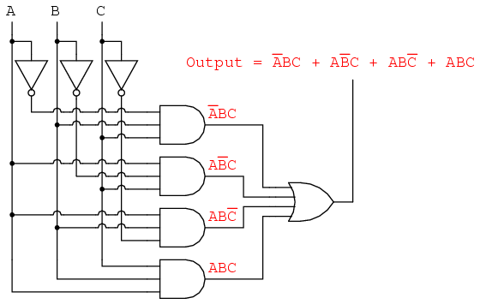
Predicates
Live Demo

Slide 30
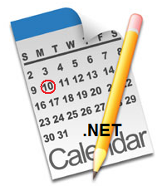
Events

Slide 31
Events
In component-oriented programming components send events to their owner
Events are notifications of something
For example moving the mouse causes event
The object which causes an event is called event sender
The object which receives an event is called event receiver
To be able to receive an event the event receivers should first "subscribe for the event"

Slide 32
Events in .NET
Events in C# are special delegate instances declared by the keyword event
In the component model of .NET the
subscription
sending
receiving
of events is supported through delegates and events
public event SomeDelegate eventName;

Slide 33
Events in .NET (2)
The C# compiler automatically defines the
+= and -= operators for events
+= subscribe for an event
-= unsubscribe for an event
No other operations are allowed
Events can predefine the code for subscription and unsubscription

Slide 34
Events vs. Delegates
Events are not the same as member fields of type delegate
Events can be members of an interface unlike delegates
Calling of an event can only be done in the class where it is defined
By default the access to the events is synchronized (thread-safe)
≠
public MyDelegate m;
public event MyDelegate m;

Slide 35
Events – Convention
.NET defines a convention for naming the events and a standard parameters
Delegates which are used for events:
Have names formed by a verb + EventHandler
Accept two parameters:
Event sender – System.Object
Inheritor of System.EventArgs type, which contains information about the event
No return value (return void)

Slide 36
Events – Convention (2)
Example:
Events:
Are declared public
Begin with a capital letter
End with a verb
public delegate void ItemChangedEventHandler(
object sender, ItemChangedEventArgs eventArgs);
public event ItemChangedEventHandler ItemChanged;

Slide 37
Events – Convention (3)
To fire an event a special protected void method is created
Having name like OnVerb()
The receiver method (handler) is named in in the form OnObjectEvent :
protected void OnItemChanged()
{
…
}
private void OnOrderListItemChanged()
{
…
}

Slide 38
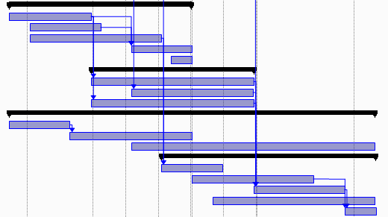
Defining and Using Events
Live Demo

Slide 39

The Delegate System.EventHandler

Slide 40
The Delegate System.EventHandler
System.EventHandler defines a reference to a callback method, which handles events
No additional information is sent about the event, just a notification:
Used in many occasions internally in .NET
The EventArgs class is base class with no information for the event
public delegate void EventHandler(
Object sender, EventArgs e);

Slide 41
The Delegate System.EventHandler (2)
public class Button
{
public event EventHandler Click;
public event EventHandler GotFocus;
public event EventHandler TextChanged;
...
}
public class ButtonTest
{
private static void OnButtonClick(object sender,
EventArgs eventArgs)
{
Console.WriteLine("OnButtonClick() event called.");
}
public static void Main()
{
Button button = new Button();
button.Click += new EventHandler(OnButtonClick);
}
}

Slide 42

The Delegate System.EventHandler
Live Demo

Slide 43
The Delegate System.EventHandler<T>
If an event brings additional data the generic EventHandler<T> delegate is used
TEventArgs is a custom type derived from EventArgs and holds the event data
Example:
Mouse click event hold information about the mouse position, which button is clicked, etc.
public delegate void EventHandler<TEventArgs>(
Object sender, TEventArgs e) where TEventArgs : EventArgs

Slide 44
Events as Members in Interface
Events can be interface members:
When implementing an event from interface a specific add / remove methods can be defined:
public interface IClickable
{
event ClickEventHandler Click;
}
public event ClickEventHandler Click
{
add { … }
remove { … }
}

Slide 45
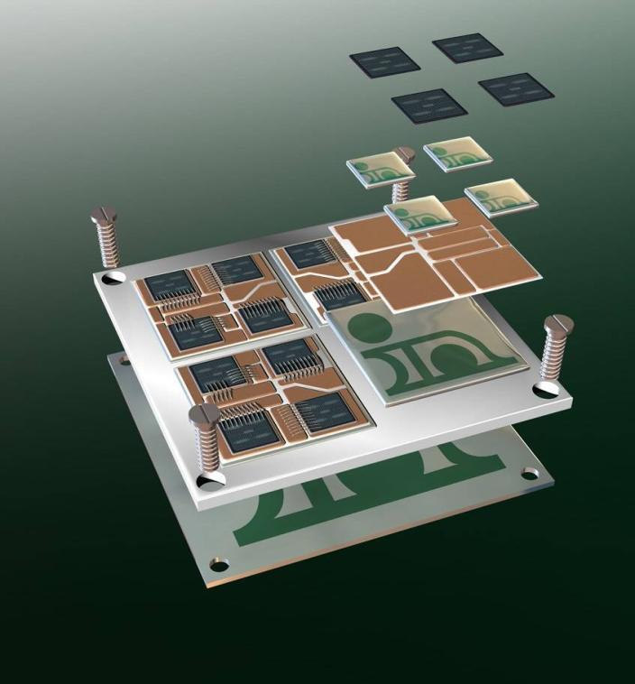
Events as Interface Members
Live Demo

Slide 46
Interfaces vs. Events vs. Delegates
In .NET we can implement "callback" by using interfaces, delegates or events
When to use interfaces?
If a class exposes lots of callback methods as a group
When to use events?
When we develop components which have to notify their owner about something
When we need compatibility with the .NET component model

Slide 47

Interfaces vs. Events vs. Delegates (2)
When to use delegates?
When we have a single callback method which is not confined to the .NET component model

Slide 48
Delegates and Events
?
?
?
?
?
Questions?
?
?
?
?
?
?

Slide 49
Exercises
Explain what are the delegates and events in .NET.
By using delegates develop an universal static method to calculate the sum of infinite convergent series with given precision depending on a function of its term. By using proper functions for the term calculate with a 2-digit precision the sum of the infinite series:
1 + 1/2 + 1/4 + 1/8 + 1/16 + …
1 + 1/2! + 1/3! + 1/4! + 1/5! + …
1 + 1/2 - 1/4 + 1/8 - 1/16 + …

Slide 50
Exercises (2)
What does the approved convention for events in .NET recommend?
Define a class Person, which describes a person and has the following properties: first name, last name, gender, birth date. Add an event of the system delegate System.EventHandler to the Person class per each of its properties, that fires when the value of the property changes.

Slide 51
Exercises (2)
Create a class PropertyChangedEventArgs, inheritor of the System.EventArgs class and define 3 properties – name of the property changed (string), old value (object) and new value (object) together with a proper constructor. Create a delegate PropertyChangedEventHandler to handle property change events, that accepts 2 parameters – a sender object and a PropertyChangedEventArgs.

Slide 52
Exercises (2)
Write another version of the Person class, which has just one event named PropertyChanged of type PropertyChangedEventHandler, which activates when any of the properties of the class changes (called with proper parameters respectively).
Extract the definition of the PropertyChanged event in a separate interface IPropertyChangeNotification and change the class in such a way that it implements the interface.

